Slide 1
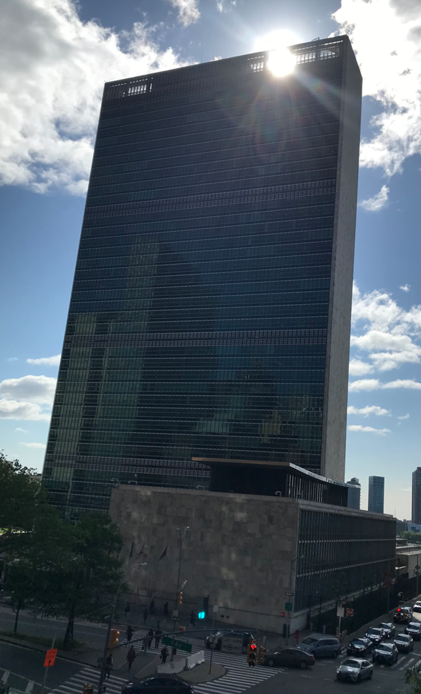
Highlights of the High-Level Meeting on the Midterm Review of the Sendai Framework, NY, May 18-19, 2023

Slide 2
Conference Structure: 2 Segments
Risk Reduction Hub: May 17-19
High Level Meeting: May 18-19
May 18: General Assembly Hall（Opening, Political Declaration, Statements）
May 19: Trusteeship Council Chamber（4 Multi-stakeholder Panels, Closing）

Slide 3
Risk Reduction Hub
Wednesday, 17 May 2023
08:15-09:45: Scaling Up Risk Sensitive Urban Development
10:00-11:30: Next generation disaster risk analytics: Strengthening the DRR Data Ecosystem to meet tomorrow’s global challenges
10:30-12:00: Human Mobility in the Context of Disasters
11:30-13:00: Accelerating Action for Gender Responsive Disaster Risk Reduction
13:15-14:30: Changing our Future: Children are taking action to end violence against children by building resilience and addressing climate change
13:15-14:30: SAMOA and Sendai; Twin Pillars for a Resilient and Productive Future in all Small Island Developing States, by harnessing women's leadership
13:15-14:45: Accelerating implementation of DRR and resilience in infrastructure
15:00-16:30: Synergizing Climate Action and Disaster Risk Reduction
15:00-16:30: Adopting Intersectionality to DRR using Disability as an Example
15:00-16:30: Risk Proofing Sustainable Development
16:30-18:00: Private Investment in Disaster Risk Reduction for Resilience
16:30-18:00: A whole of Society Approach: the role of non-state actors in the Sendai Framework
Thursday, 18 May 2023
08:15-09:45: Early Warnings for All - Closing the gap and scaling up good practices
08:15-09:45: Disaster Risk Reduction in Countries Affected by Multidimensional Crisis
08:15-09:45: Roles of States for Promoting Investments in Disaster Risk Reduction towards Resilient and Sustainable Future
08:30-09:30: Disaster Risk Reduction and Education (online event)
09:00-10:00: Meeting of ARISE members and partners
11:00-12:30: Meeting of non-state stakeholders attending the High Level Meeting of the midterm review of the Sendai Framework
Friday, 19 May 2023
08:15-09:45: Working with Nature for Resilience
13:15-14:45: Scaling up resilience and reducing disaster risk in LLDCs

Slide 4
9

Slide 5
Intervention: 1. Do not set the bar too high when making a framework for disaster loss and damage by UN Statistical Bureau as many NDMOs had just started to develop their own system for counting loss and damage 2. Horizontal and vertical coordination is a key to develop such a system 3. Sendai monitoring is not only for central government (NDMOs). It should be implemented and promoted at the sub-national levels. Tohoku University supported the City of Sendai to monitor the Sendai progress to achieve global targets by the City of Sendai. 4. The mayor, Ms. Kohri Kazuko, presented the outcomes during the meeting in NY

Slide 6
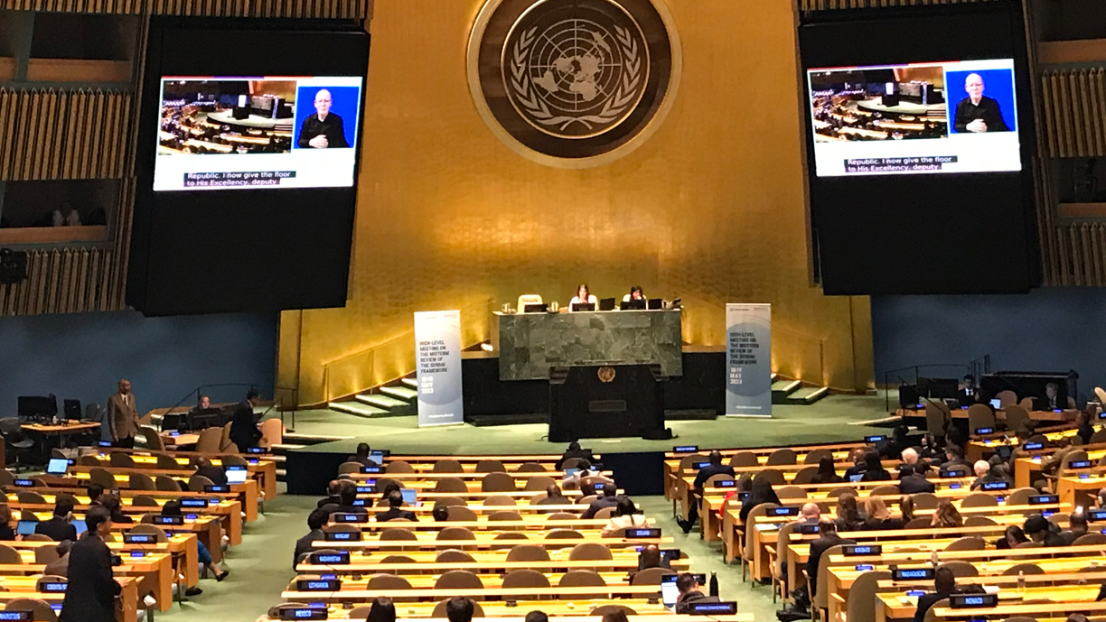

Slide 7
High-Level Meeting
Agenda
Thursday, 18 May 2023 – General Assembly Hall
10:00 – 11:00: Opening Segment
11:00 – 13:00: Plenary - Charting liveable pathways for humans and nature
13:00 – 15:00: Break
15:00 – 18:00: Plenary - Charting liveable pathways for humans and nature
Friday, 19 May 2023 – Trusteeship Council Chamber
10:00 – 11:30: Multistakeholder Panel 1 - From Managing Disasters to Managing Risk; Risk Governance fit for the 21st century
11:30 – 13:00: Multistakeholder Panel 2 - De-risking investment and reconfiguring the global financial system - moving from risk generation to risk reduction
13:00 – 15:00: Break
15:00 – 16:30: Multistakeholder Panel 3 - Strategic foresight and risk reduction to accelerate implementation of the 2030 Agenda for Sustainable Development
16:30 – 17:45: Multistakeholder Panel 4 – A collective responsibility – localising disaster risk reduction
17:45 – 18:00: Closing segment

Slide 8
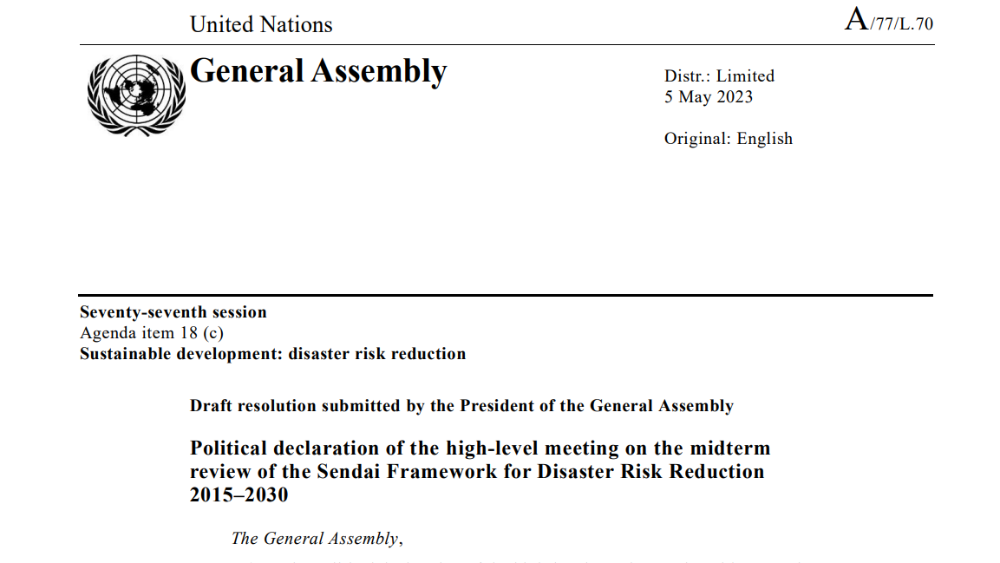

Slide 9
Political Declaration (negotiated document)
Structure:
1-13: 13 paras for overall (942 words)
14-20: 7 paras for the Sendai Priority 1 (603 words)
21-26: 6 paras for the Sendai Priority 2 (810 words)
27-33: 7 paras for the Sendai Priority 3 (817 words)
34-39: 6 paras for the Sendai Priority 4 (722 words)
40-50: 10 paras for the follow-up and review (555 words)

Slide 10
Political Declaration (negotiated document)
‘Not good’ words were used many times
Concern – 11 words
Deeply concern – ６ words
Need – 28 words
Strengthen -24 words
Enhance -10 words
Call -15 words
Urge -4 words
Promote – 14 words
Welcome – 6 words
Recognize – 16 words
Reaffirm – 5 words
Reiterate – 5 words

Slide 11
Political Declaration (negotiated document)
5. While we recognize that the implementation of the Sendai Framework is delivering positive results, we are deeply concerned that the pace of implementation is not sufficient nor equal. Insufficient access to disaster data, risk knowledge, technology and financing, as well as insufficient prioritization and action on disaster risk reduction, including through climate action, continue to hinder progress in implementing the Sendai Framework.
6. We express deep concern at the increasing frequency and intensity, as well as the number and scale of disasters and their devastating impacts, which have resulted in massive loss of life, food insecurity and famine, biodiversity loss, water-related
challenges, increased displacement, humanitarian and development needs and long-term negative economic, social and environmental consequences, especially for those in vulnerable situations throughout the world, and which are undermining progress towards sustainable development, the implementation of the 2030 Agenda for Sustainable Development and the achievement of its Sustainable Development Goals, in particular for the least developed countries, small island developing States, landlocked developing countries and African countries, as well as middle-income countries facing specific challenges.
7. We express deep concern also that economic losses are rising as a result of the increasing number and value of assets exposed and vulnerable to hazards.
30. We are deeply concerned that public and private investments to anticipate, plan for, reduce and prevent disaster risk remain insufficient and do not match the scale of existing and future risk. We reaffirm the importance of investments that contribute to the reduction of disaster risk, the protection of lives, livelihoods and assets, resilience-building and the realization of sustainable development and poverty eradication, particularly in the least developed countries, small island developing
States, landlocked developing countries and African countries, as well as middle-income countries facing specific challenges.

Slide 12
Political Declaration (negotiated document)
34. While we welcome the progress made in enhancing the effectiveness of disaster
prevention, anticipation, preparedness and response in the design and implementation
of multi-hazard early warning systems since 2015, particularly through enhanced
regional cooperation mechanisms and by the United Nations and its partners, we are
deeply concerned that build back better principles have not been applied systematically.
35. We are deeply concerned that coverage of and accessibility to multi-hazard early
warning systems remains inadequate in all countries and emphasize the need to
urgently extend the reach of multi-hazard early warning systems everywhere,
especially in developing countries and in particular in least developed countries, small
island developing States, landlocked developing countries and African countries, as
well as middle-income countries facing specific challenges.

Slide 13
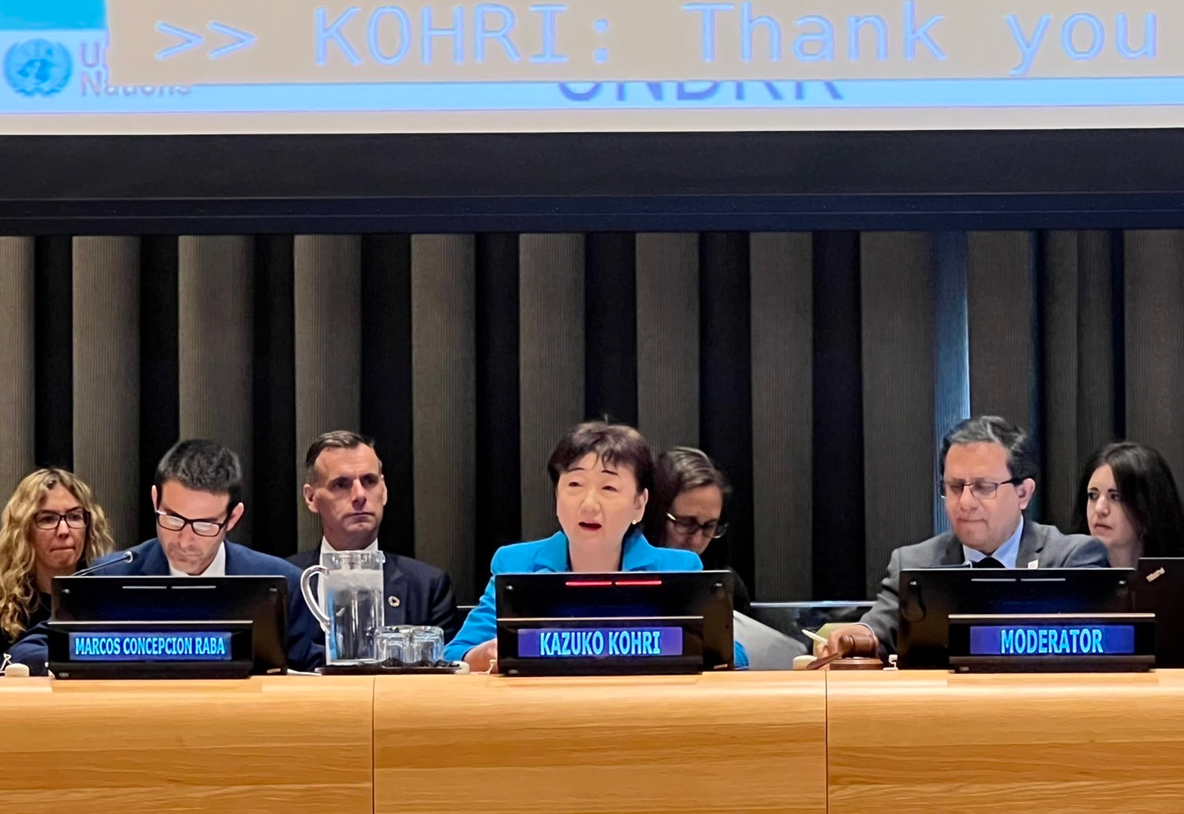
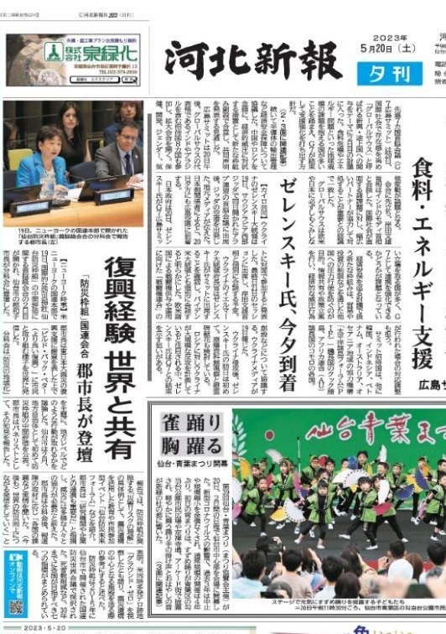
Sendai monitoring – why not conducted at the municipality level?

Slide 14
A few additional slides:
1. WMO’s Expert Team on Cataloguing Weather, Water, Climate, Environmental, and Space
Weather Hazardous Events
2. Smart Phone based Pin-Point Alert System
World Bosai Forum 2025

Slide 15
1. Expert Team on Cataloguing of Weather, Water, Climate, Environmental and Space Weather
Hazardous Events (ET-CHE)
The WMO Expert Team on Cataloguing Weather, Water, Climate, Environmental, and Space
Weather Hazardous Events, abbreviated as Expert Team on Cataloguing Hazardous Events (ET-CHE) to assist the technical commission in addressing the EC-76 resolution 3.1(11)/1 and related EC-76 resolutions.
The purpose of the ET-CHE is to contribute to the development and operationalization of the WMO Cataloguing of Hazardous Events (WMO CHE).
Deliverables
a) Update and maintenance of WMO-CHE Events list and submission to the appropriate WMO
Constituent body process;
b) Review and coordination with relevant expert’s updates to the UNDRR/ISC HIPs and
submission to the appropriate constituent body process;
c) Development of CHE-related training materials to aid in CHE implementation and use of CHE
data and information;
d) Development of recommendations on WMO CHE operational and organizational aspects to
be included in the technical regulations of the GDPFS and WIS

Slide 16
Tohoku University is willing to host the WMO’s CHE system (global hazard database) in conjunction with
the Global Centre for Disaster Statistics, which is a joint initiative with UNDP
We will be able to identify quantity of how many climate-related hazards are occurring and how much
degree (wind speed, precipitation, etc.) of hazard is influenced/aggrebated by climate change
Also, we would be able to calculate how much damage and loss was increased by climate change
This would trigger a game change for COP discussion because each country would know this in number.
Who is affected and how much!
Being served as an Executive Committee Member of the Warsaw International Mechanism on Loss and
Damage of the UNFCCC in 2019, the bottle neck was luck of loss and damage data!
With precise loss and damage data caused by climate change, policy makers can develop a better policy
to invest where appropriate.
All of this would significantly contribute to climate change adaptation to reduce damage and loss, including
disaster-related ones.

Slide 17
Smart Phone Based Pin-Point Alert System
Mass evacuation should be avoided if possible
In the fall of 2019, more than 600,000 Sendai citizens (total population is 1 million) were under evacuation
order due to an approaching strong typhoon.
Where to accommodate such a large number of evacuees? Impossible!
Not everyone had to evacuate.
We should be able to identify who are those who really are in high risk and should evacuate.
Pinpoint-assessment = household level disaster risk assessment
Plus
Provide an assistance for those who cannot evacuate by themselves
The latter led to develop a smart phone based Pin-Point Alert System which should have a both-way
communication function. People who need help can ask help.
Fujitsu and Tohoku University is developing this now

Slide 18
Government of Japan modified the law
Basic Act on Disaster Management (Act No. 223 of 1961) modified in May 2021
The solution was to encourage municipalities to develop individual evacuation plans.
This was because more aged and disabled people became disaster victims in recent years
2019 Typhoon: 65%
2020 July Torrential Rain:79%
The Smart Phone Based Pin-Point Alert System will be developed soon

Slide 19
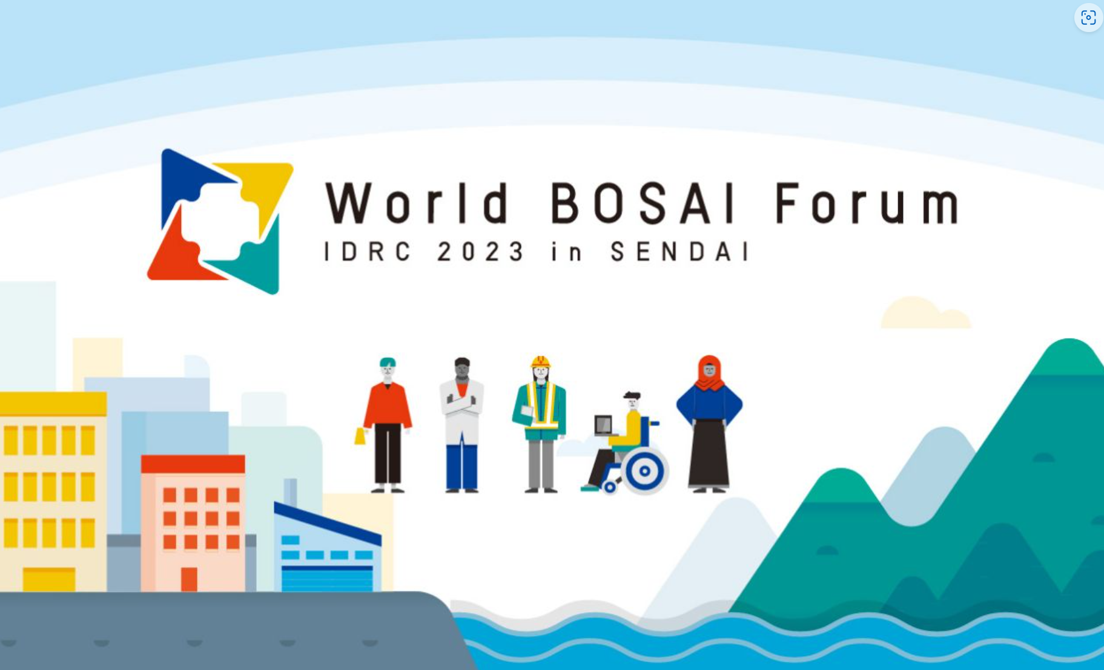
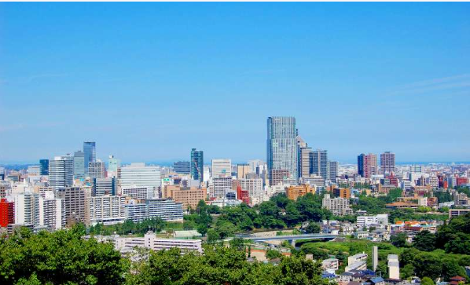
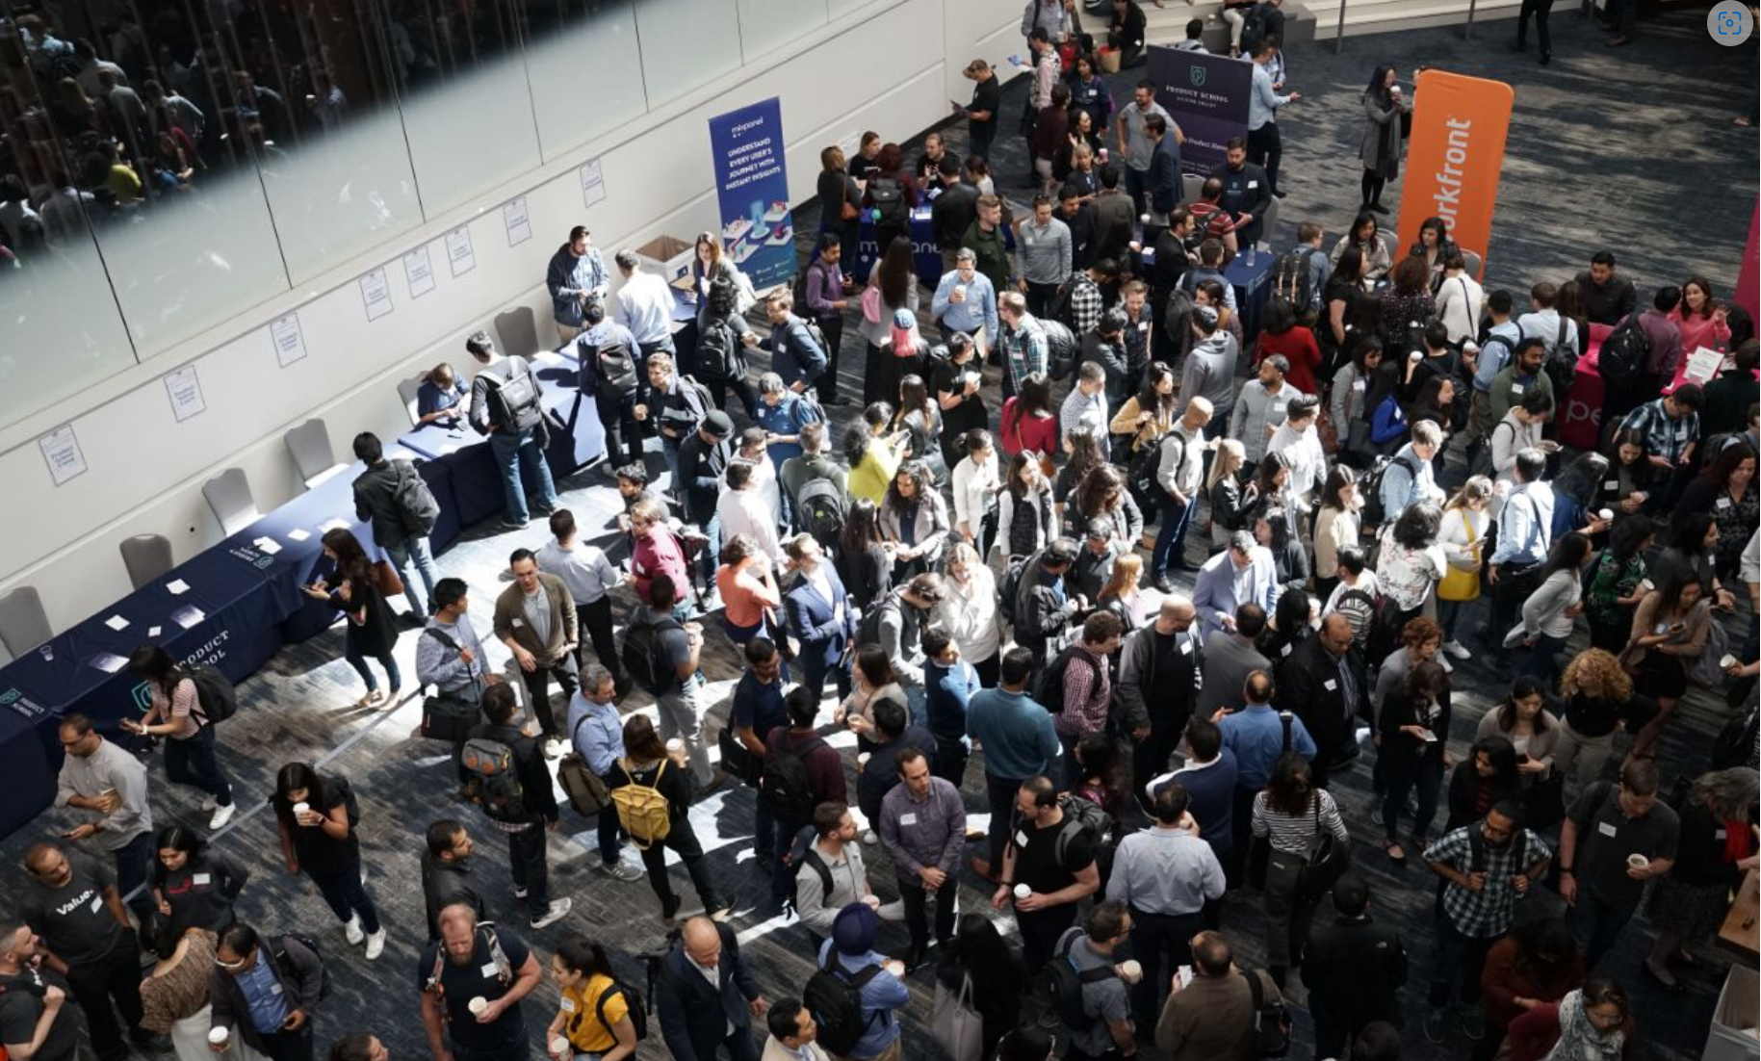
3. World Bosai Forum 2023 was held in Sendai, March 10-12
5,412 participants from 40 countries
The Forum discussed tangible solutions for disaster risk reduction and
disseminated information to the world through dialogue among
international organizations, governments, academia, private sector, NGOs,
and citizens
The forum came up with recommendations to the Mid-Term Review
Process of the Sendai Framework for Disaster Risk Reduction
https://worldbosaiforum.com/media/files/_u/wbf2023/report/
WBF%20Sendai%20Declaration%202023%20en.pdf

Slide 20
Preamble
World BOSAI Forum 2023/IDRC 2023 in SENDAI was attended by 5,412 participants from 40 countries. The Forum discussed tangible solutions for disaster risk reduction and disseminated information to the world through dialogue among international organizations, governments, academia, private sector, NGOs, and citizens. The Forum voiced its desire to see conflicts around the world resolved as soon as possible, since conflict is the biggest impediment to disaster risk reduction. Conflict is one of the reasons why the Sendai Framework for Disaster Risk Reduction, the Paris Agreement, and the Sustainable Development Goals (SDGs) have fallen far behind in achieving their goals. On the other hand, the Forum emphasized that international cooperation on disaster risk reduction may be beneficial in resolving conflicts. The Covid-19 Pandemic took a tremendous toll, and the Sendai Framework for Disaster Risk Reduction pointed out the importance of being prepared in advance and of maintaining the health care sector in times of emergency. A special session on earthquakes in Turkey and Syria discussed challenges and solutions by academia and practitioners. It was pointed out that while the development of new technologies is effective for disaster risk reduction, we already have a substantial amount of viable technology; the problem is that they are not being disseminated throughout society. A human-centered approach, including inclusiveness and sustainability in disaster risk reduction, was suggested to address the problem that some socio-economic groups are more vulnerable to disasters. Education and public awareness, including picture books and disaster storytelling associated with disaster-related museums, are useful to keep memories of disaster experiences alive in the next generations. Several sessions emphasized that inclusion of the perspectives of women, children and the disabled would further reduce disaster risks. City of Sendai conducted a mid-term review on the Sendai Framework which helps understand disaster risks at the local level. The exhibition, called World BOSAI EXPO, introduced disaster risk reduction product technologies from private companies and activities of disaster risk reduction-related organizations.

Slide 21
The forum came up with recommendations to the Mid-Term Review Process of the Sendai Framework for Disaster Risk Reduction as below.
Our recommendations:
1. The Forum recognizes the high value of the Sendai Framework for Disaster Risk Reduction and the need to accelerate its implementation. We respect the important role of the United Nations Office for Disaster Risk Reduction for that goal. Ultimately, promotion and review of the Sendai Framework must lead to practice of disaster risk reduction in each country and to strengthen national and local mechanisms to implement disaster risk reduction. This includes strengthening of the National Platforms and their secretariat, in many cases National Disaster Management Organizations/Authorities (NDMOs).
Understanding disaster risk (priority area 1 of the Sendai Framework for DRR)
2. We need sound and reliable evidence based on data collection and analysis, including risk assessment, to further enhance the connection between risk information and DRR decisions and actions.
3. To enhance credibility, we must fully utilize and refer to historical disaster loss and damage data and statistics. We need to improve accuracy in the calculation of economic losses, including those of infrastructures.
4. We need consistent and understandable metrics regarding disaster risk reduction and building resilience. How resilient is resilient enough? There must be substantial discussions among the relevant stakeholders within and across countries.
5. The Sendai monitoring should be done not only by national governments but also local governments, including municipalities, to understand disaster risks at the local level.

Slide 22
Strengthening disaster risk governance to manage disaster risk (priority area 2 of the Sendai Framework for DRR)
6. We need more robust education programs for securing skilled human resources dedicated to disaster risk reduction. More transdisciplinary practical programs should be inaugurated to formulate an optimized set of DRR actions based on scientific evidence.
7. We must strengthen the National Platform for Disaster Risk Reduction and coordination with national organizations that invest in disaster risk reduction such as the Ministry of Public Works, Construction, Planning, and Finance.
8. We must stress the importance of balance between structural and non-structural measures to reduce disaster risk. An optimal combination of disaster risk reduction measures is needed to maximize the effectiveness of disaster risk reduction by various stakeholders with limited resources. A disaster risk reduction effectiveness metric needs to be established for this purpose.
9. We encourage further involvement of the private sector in investments in disaster risk reduction. Private sector involvement would be more effective if there is a national strategy and budget for disaster risk reduction at the local level.
10. Specific actions (tangible, measurable, visible, ‘mapable,’ GIS-based actions) are needed at the local level. The global level agenda should be for local level actions. Since all disasters affect the local level, activities must be action oriented.

Slide 23
Investing in disaster risk reduction for resilience (priority area 3 of the Sendai Framework for DRR)
11. Continued investment in disaster risk reduction, including cooperation and guidance with private investors is necessary for substantial risk reduction. We need to secure a sustainable budget to achieve resilience in the event of a disaster.
12. We need to link disaster risk reduction with urban and rural land use planning. The continued investment in land use planning for disaster risk reduction will significantly reduce the short-term impacts of climate change.
13. We need to develop better financial mechanisms for resilient infrastructure, including insurance of public assets.
14. Pre-disaster investment and DRR actions should be optimized based on the economic and social development level of the countries and regions. While Early Warning Systems are effective to achieve Sendai Framework’s global targets A and B, we also have to consider combining with other effective DRR measures to attain Sendai Framework’s global targets C and D. Enhancing disaster preparedness for effective response and to Build Back Better in recovery, rehabilitation and reconstruction (priority area 4 of the Sendai Framework for DRR)
15. Pre-disaster recovery planning derived from the Build Back Better principles learned from the Great East Japan Earthquake and Tsunami can reduce the recovery time and serve as effective pre-disaster DRR investment.
16. Restoration in the "hard" aspects of recovery and reconstruction, such as infrastructure, does not necessarily mean "recovery" for each and every one of the victims. For example, the rate of suicide among disaster victims remains higher even several years after large-scale disasters. In that sense "Build Back Better" should highlight individual victims' psychosocial status and take necessary steps as well. Such steps will even encourage those people's engagement in future risk reduction and enhance resilience of the local community.

Slide 24
Cross-cutting and emerging issues
17. Scientific global collaboration networks should be strengthened with more involvement of academia to share successful cases and to improve the accuracy of disaster risk assessment.
18. The forum identified a need for an intergovernmental venue to discuss key disaster risk reduction issues from the NDMO’s perspective. These include sharing of national and regional good practices accumulated during the 2015-2023 period of the Sendai Framework implementation period, periodic review of the Sendai Framework, and the climate change adaptation issues mentioned above.
19. The forum concerned that disaster risk reduction issues related to climate change are currently discussed and decided without sufficient involvement of NDMOs in the global process of climate change adaptation under the UNFCCC, especially in the COP series.
20. There is a need to bridge the gap and share knowledge between countries that have long dealt with climate change and those facing climate change as a new risk. Conventional disaster risk reduction strategies are also effective for climate change-induced disasters.
21. There is a need for science-based discussions and evidence on the linkages between climate change adaptation measures and disaster risk reduction, based on solid data on disaster losses and damages at all levels

Slide 25
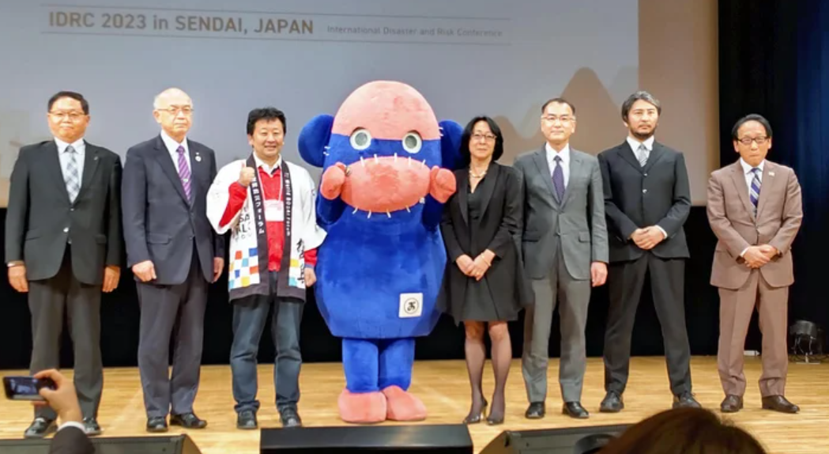
World Bosai Forum 2025 will be held in Sendai, March 7-9, 2025

